Slide 1

Airbnb Cleaning fee Analysis
Pedro Rodriguez

Slide 2


Outline
Case study
Data and exploratory analysis
Data insights (summary)
Prediction model
Q&A

Slide 3






Case study
Airbnb host
Seattle
Jan – Dec 2016
Customer's question:
Does the cleaning fee affect the monthly availability?
Do the booking prices change per location?
Do the booking prices change throughout the year?
Question
Notes:
5 Ws:
- Who is the client? – Airbnb owner
Where he lives/has Airbnb units? Seattle
Why the client reached out to you? (what he wants to know?) – the client wants to know if adding a cleaning will affect the number of bookings in his/her units
What timeframe are you using to answer the question, why 2016?

Slide 4




Data
Availability
Property type
Accommodates
Room type
Number of bathrooms
Number of bedrooms
Latitude
Longitude
Zip code
Booking price
Cleaning fee
Review score rating
Review score cleanliness
Date
Notes:
Highlight which parameters you are going to focus
Distance calculation

Slide 5

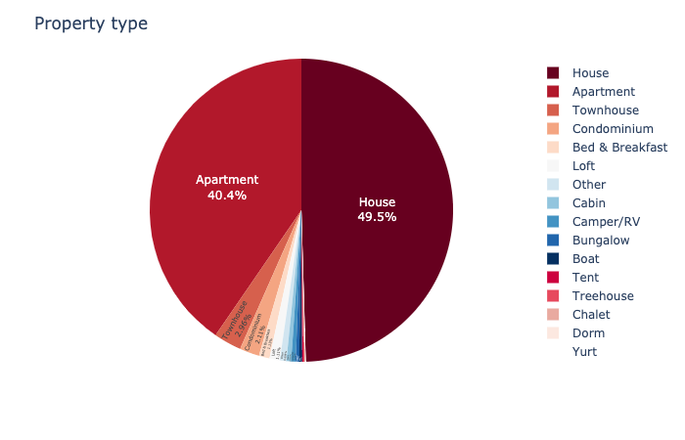
Exploratory analysis
Houses and Apartments were the selections most demanded in 2016.

Slide 6

Exploratory analysis
Property | Average Price | Average Cleaning fee
House | $132 | $42
Apartment | $123 | $39
Condominium | $151 | $55
Loft | $136 | $37
Notes:
The Airbnb market has different property types, and the data shows the customer frequently book Apartments and houses. The average price of a house booking per day is $132.35 and an apartment $122.93. The additional charge, like cleaning fees, has an average of $42.24 for houses and $38.58 for an apartment.

Slide 7
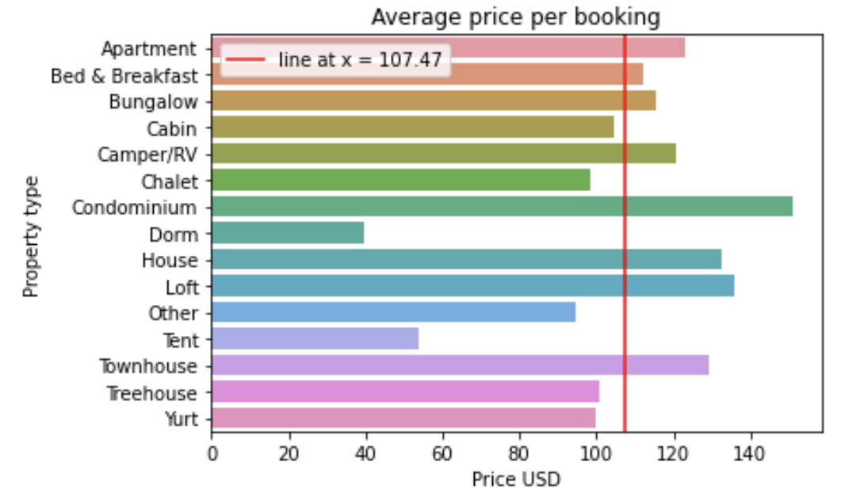
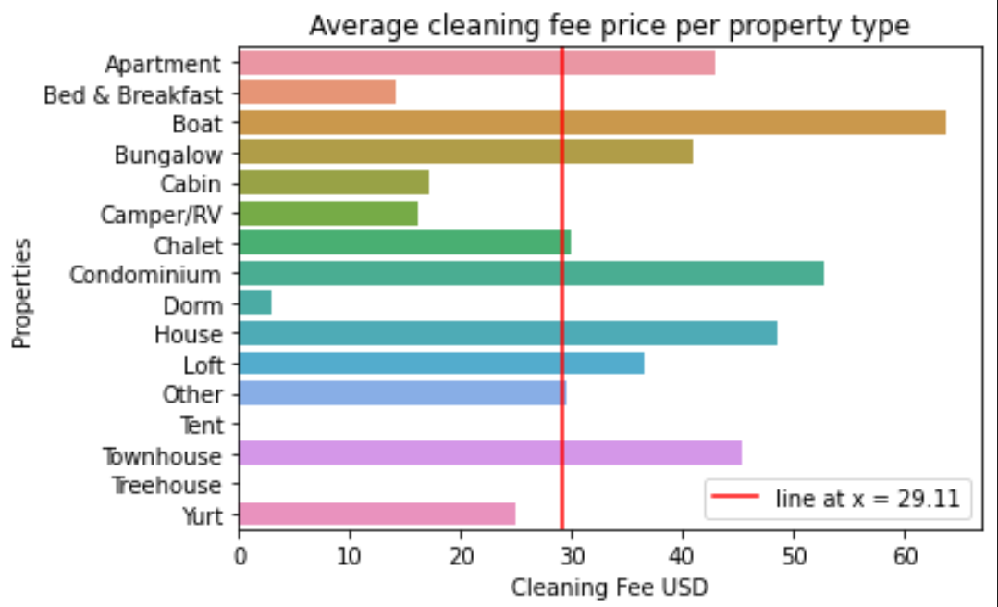
Exploratory analysis
The average booking price per day is $107.47
The average cleaning fee per day is $29.11
Notes:
The Airbnb market has different property types, and the data shows the customer frequently book Apartments and houses. The average price of a house booking per day is $132.35 and an apartment $122.93. The additional charge, like cleaning fees, has an average of $42.24 for houses and $38.58 for an apartment.

Slide 8



Exploratory analysis
→ BOOKING PRICE + AVAILABILITY
Type of analysis
Scale
Temporal
Unit
Spatial
Zip code
Notes:
Spatial and temporal analysis of booking prices and availability

Slide 9
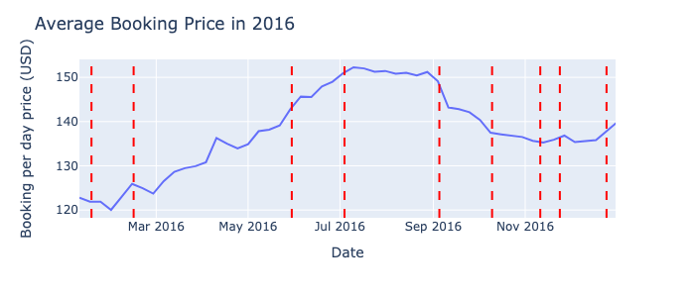
Exploratory analysis
→ BOOKING PRICE
Notes:
Exploratory data
The data that was provided is from 2016 and has 134,000 listing entries. And the first thing that I want to investigate is how Airbnb behaves throughout the year. The average price per booking slowly increases in March, and the highest season is in summer, and the availability stays consistent through 2016. This is vital information to know what price the booking price should be.

Slide 10
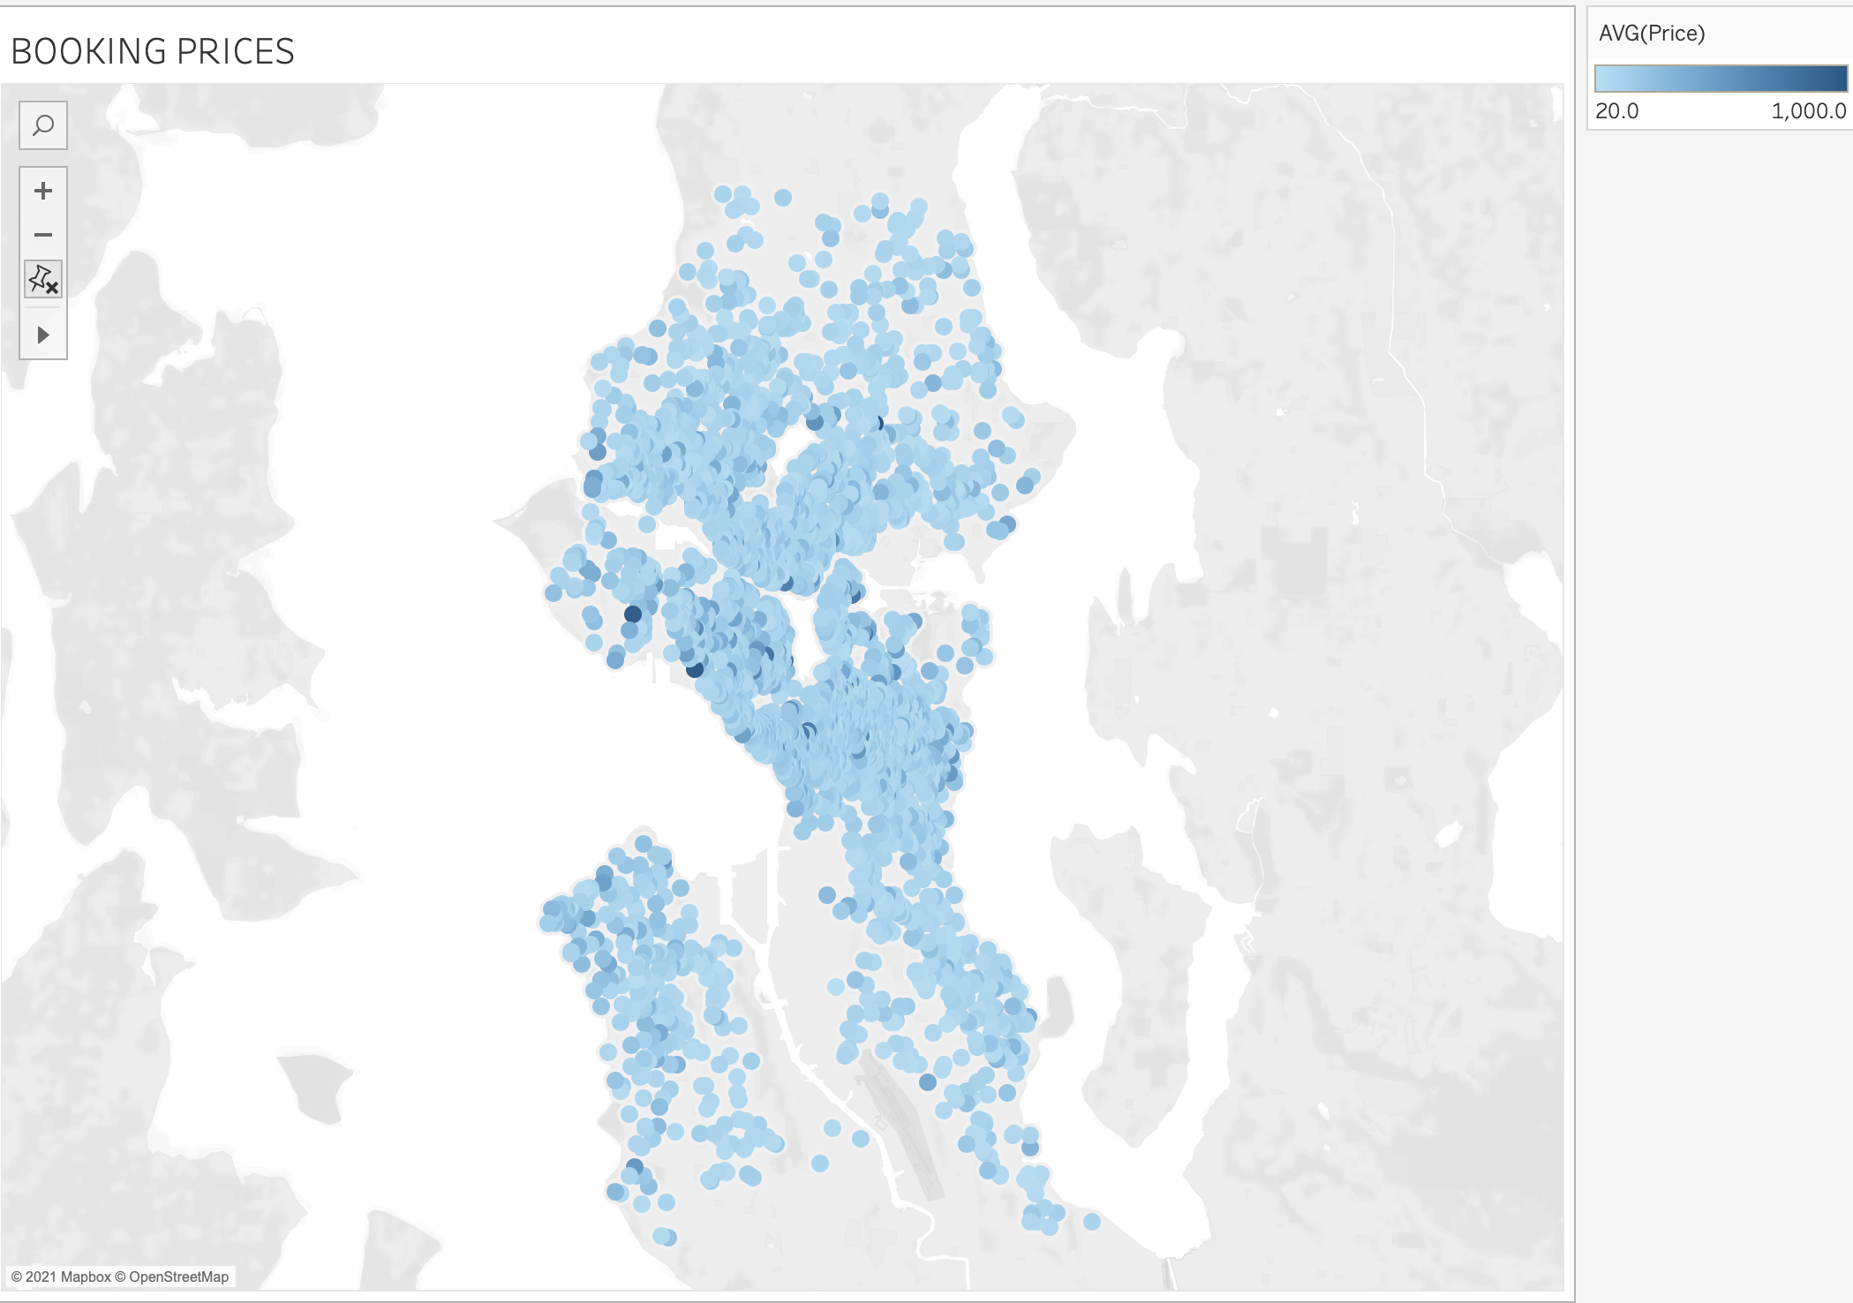


Exploratory analysis
→ BOOKING PRICE
Airbnb unit
Booking prices range from $20 - $1000 per day
Prices seem relatively even across the area
Notes:
When I check the locations, there is no specific location that has a high price per booking. It's looking pretty even the booking prices, and the same happens with the availability; nothing is showing that some locations are busier than others. When I study the correlations of these, there are no connections between location and price and location with availability.

Slide 11
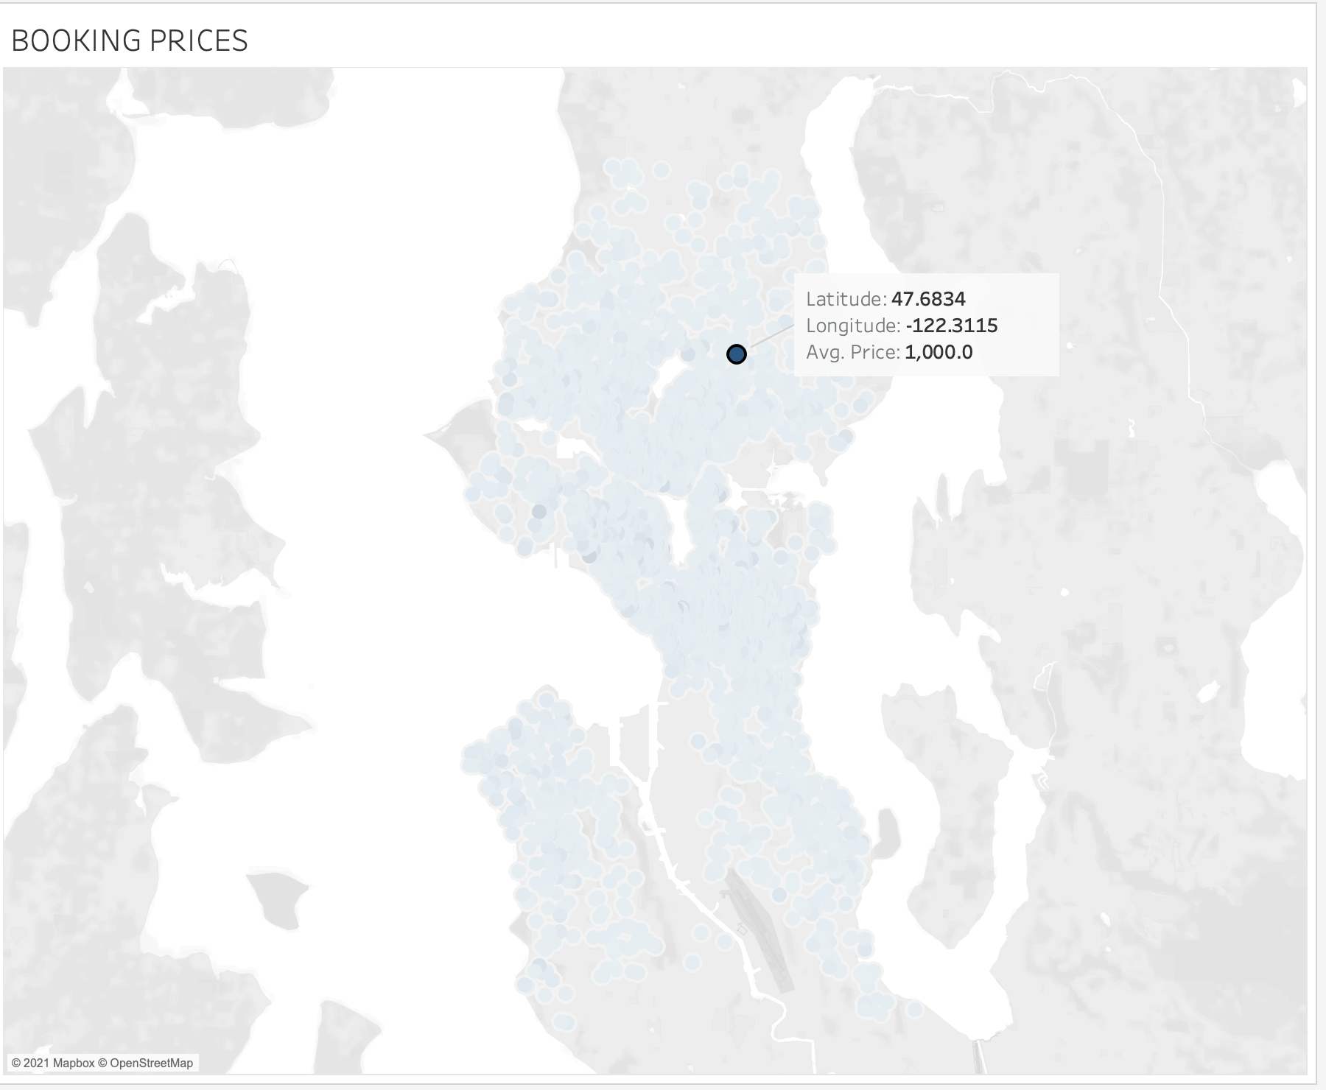
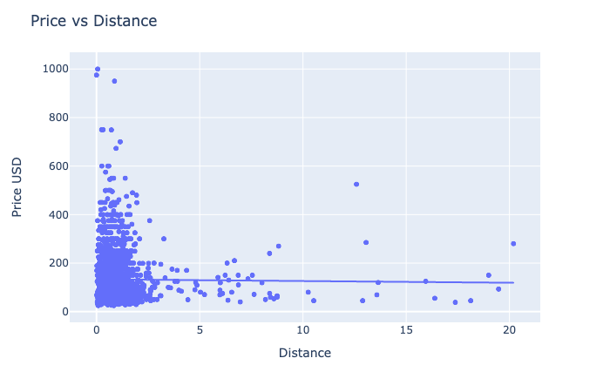
Exploratory analysis
→ BOOKING PRICE
Distance from reference point (miles)
Notes:
How you selected the reference point
- Explain that there isn’t a correlation (flat regression line) and why I think it would have made a significant difference if you choose a different reference point

Slide 12
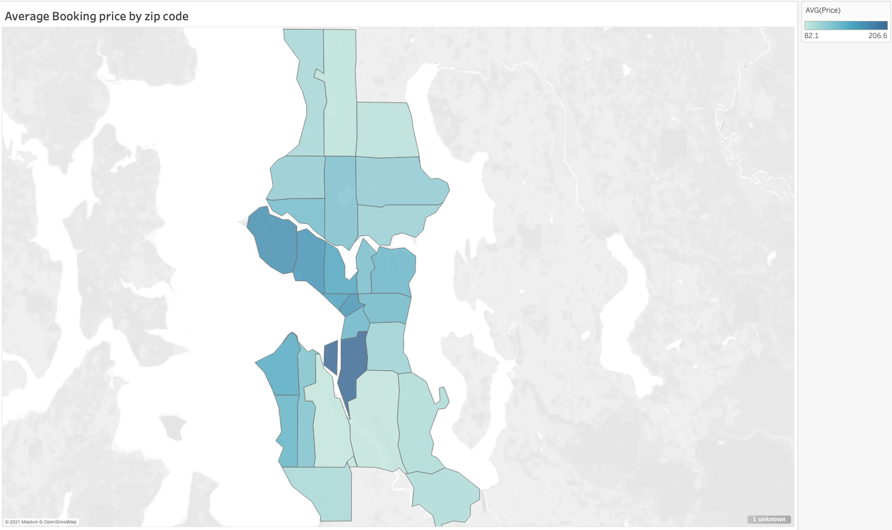
Exploratory analysis
→ BOOKING PRICE
Highest average booking price was $207
Zip code: 98134

Slide 13
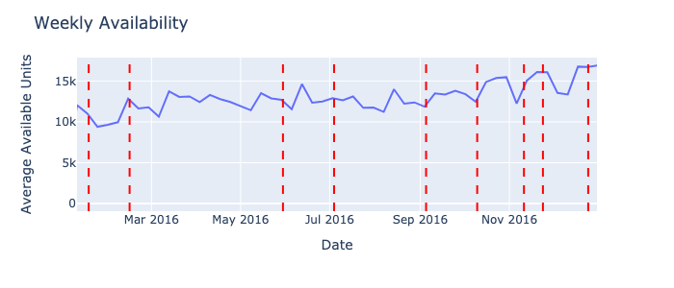
Exploratory analysis
→ AVAILABILITY
Number of available units remains relatively constant over the year
Notes:
Units available in Seatlle

Slide 14
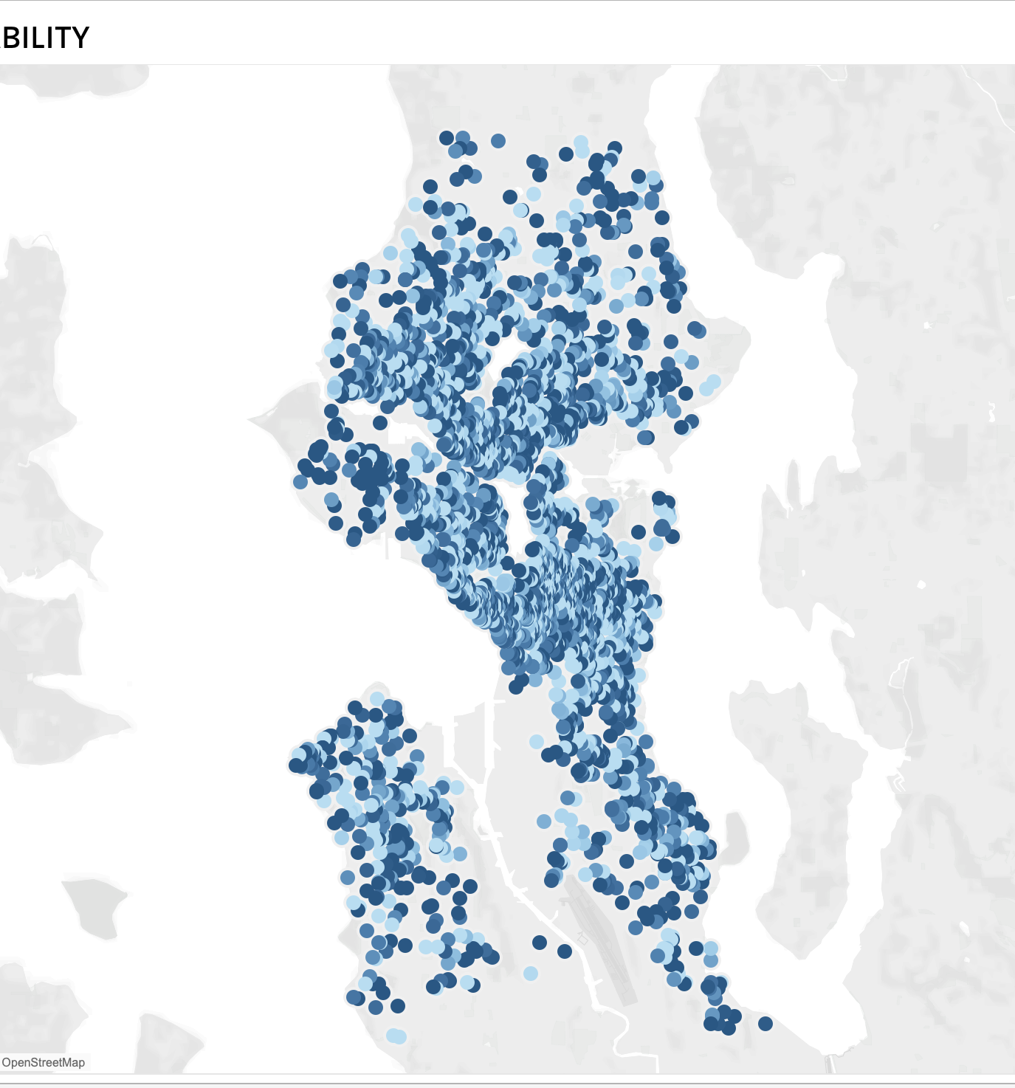
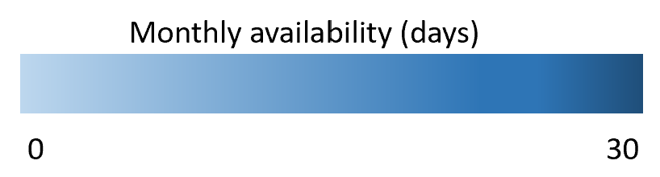
Exploratory analysis
→ AVAILABILITY
Airbnb unit
Availability = not booked (available for booking)
No significant spatial pattern
Notes:
0 = means unit was fully booked over the year
1 = not booked

Slide 15
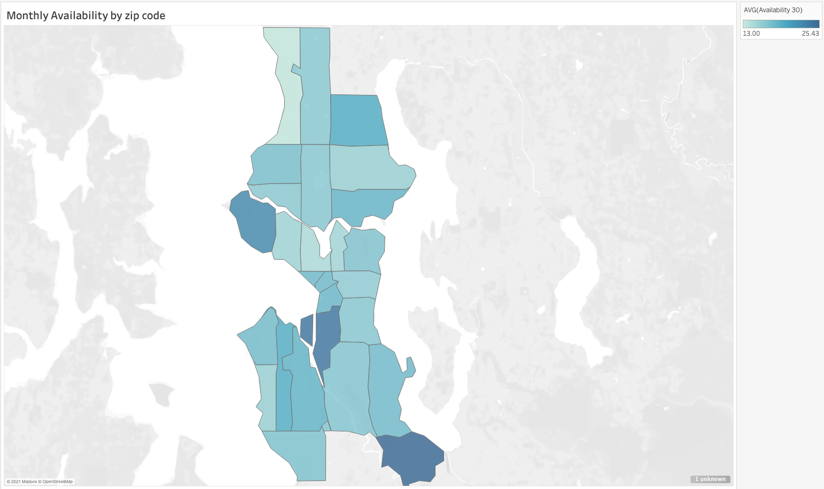
Exploratory analysis
→ AVAILABILITY
Availability = not booked (available for booking)
No significant spatial pattern
Zip code: 98134
Notes:
0 = means unit was fully booked over the year
1 = not booked

Slide 16
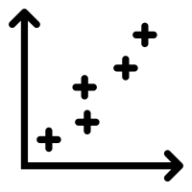
Exploratory analysis
Correlation
analysis
Notes:
Spatial and temporal analysis of booking prices and availability

Slide 17
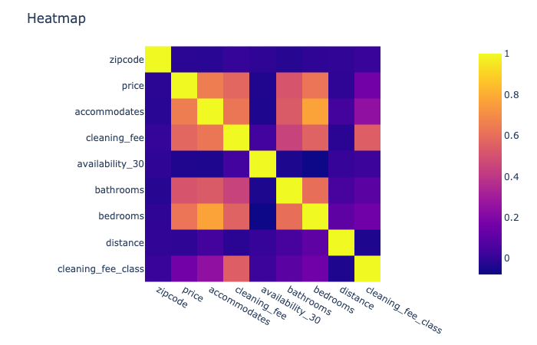
Exploratory analysis
Insights:
No correlation between cleaning fee classification and the monthly availability
Cleaning fee classification doesn’t have a strong relationship with any other features
0.65
0.58
0.51
0.63
0.16
0.57
0.04
0.51
0.52
0.16
0.25
0.54
0.02
0.10
0.16
-0.04
Notes:
When we study the correlation, we can see the cleaning fee has a weak correlation with the monthly availability. This is good because this tells us that people will keep booking if we put a cleaning fee. But have a moderate relationship with the booking price. And when we know the accommodation has a strong relationship with cost and cleaning fee.
Accommodation is the # of people staying
And when we see the scatterplot of Price and cleaning fee shows that sometimes the higher the booking price, the higher the cleaning fee could be. The same happens with the accommodation. The more people stay in Airbnb, the higher the cleaning fee and booking price could be.

Slide 18
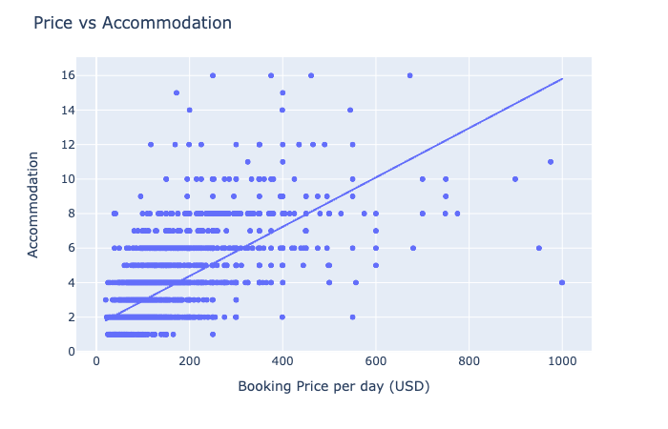
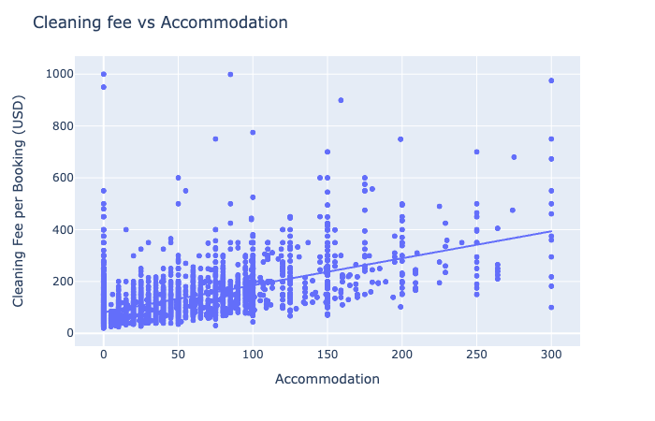
Exploratory analysis
Notes:
When we study the correlation, we can see the cleaning fee has a weak correlation with the monthly availability. This is good because this tells us that people will keep booking if we put a cleaning fee. But have a moderate relationship with the booking price. And when we know the accommodation has a strong relationship with cost and cleaning fee.
And when we see the scatterplot of Price and cleaning fee shows that sometimes the higher the booking price, the higher the cleaning fee could be. The same happens with the accommodation. The more people stay in Airbnb, the higher the cleaning fee and booking price could be.

Slide 19

Summary
Most of the Airbnb units in Seattle are houses and apartments
The booking price per day doesn't depend on the location.
Adding a cleaning fee to the booking does not affect the customer's decision to book an Airbnb.

Slide 20
Prediction model
Build and train five different models.
The accuracy score will be the evaluation method for the models.
The score should not below 0.60.
The model will predict Airbnb prices.
Notes:
In this process, we are going to build and train five different types of linear regression models which are the OLS model, Ridge regression model, Lasso regression model, Bayesian regression model, Elastic Net regression model. For all the models, we are going to use the pre-built algorithms provided by the scikit-learn package in python. And the process for all the models are the same, first, we define a variable to store the model algorithm, next, we fit the train set variables into the model, and finally make some predictions in the test set.

Slide 21
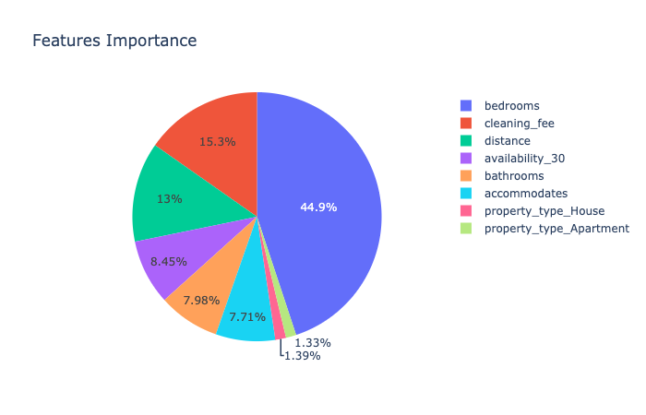
Feature Selection & Data Split
Train datasets
Test dataset
Models:
Linear Regression
Random Forest
Gradient Boost
Extreme Gradient Boost

Slide 22
Models Result
Test score
(Apartments and Houses)
Test score
(Houses)
52%
66.8%
Base linear Regression
Base linear Regression
49%
60%
The prediction model doesn’t perform well with Apartment and House prices.
The prediction model has better performance with the house’s prices.
Base Random Forest
Base Random Forest
52%
62%
Base Gradient Boost
Base Gradient Boost
49%
56%
Base XGB
Base XGB

Slide 23
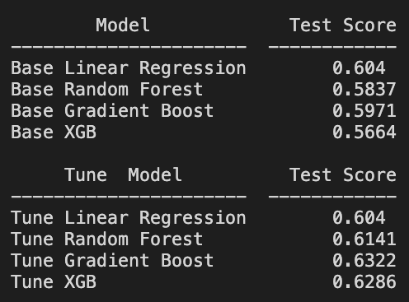
Models tuning
Model Accuracy Test
66.8%
64%
Tune linear Regression
Tune Gradient Boost
58%
61%
Tune Random Forest
Tune XGB

Slide 24
Q & A

